Slide 1
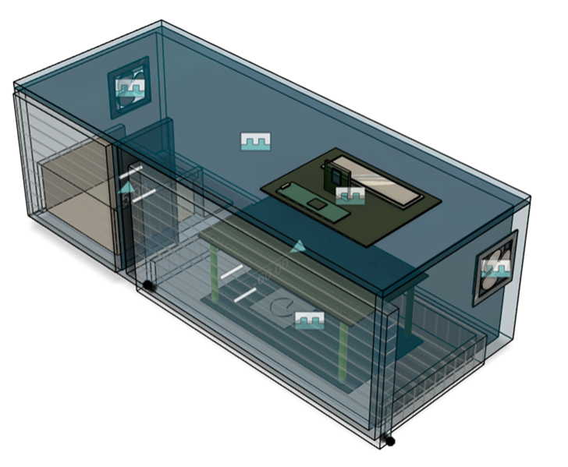
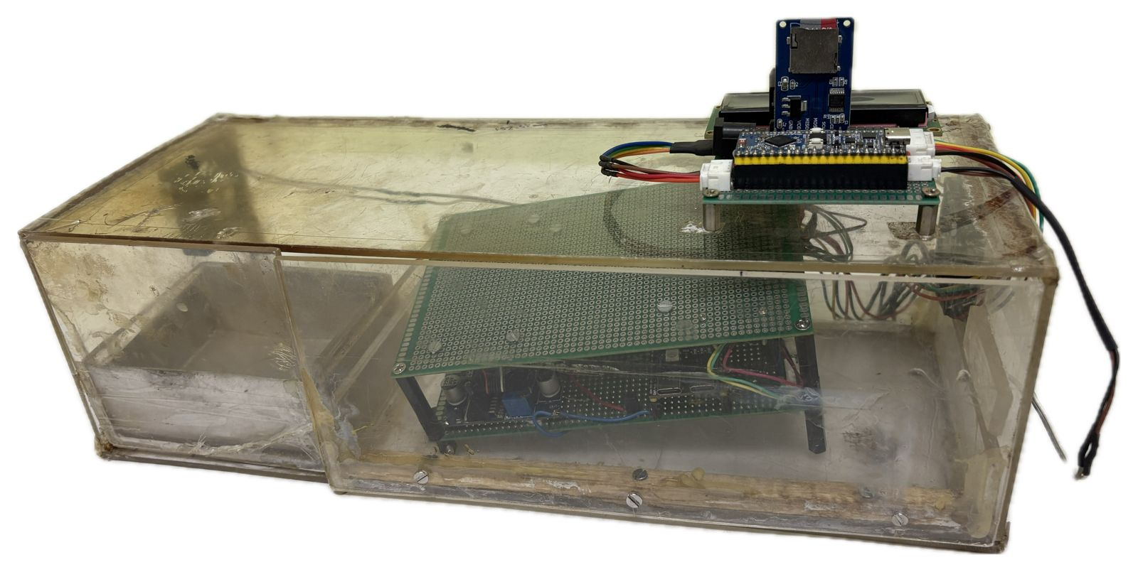
Inlet Fan
TINYML Microcontroller
TINYML Microcontroller
11.6 cm
Activity Slot
Outlet Fan
35 cm
Activity Slot
14 cm
Device Slot
Device Slot

Slide 2
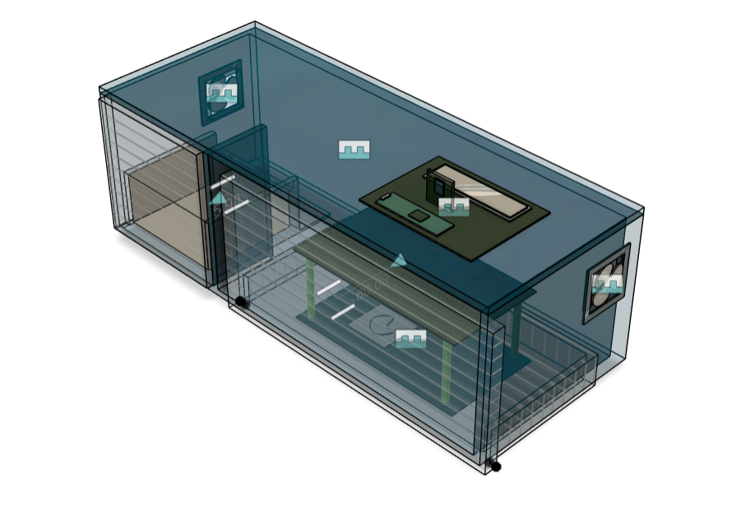
10CM
10CM

Slide 3
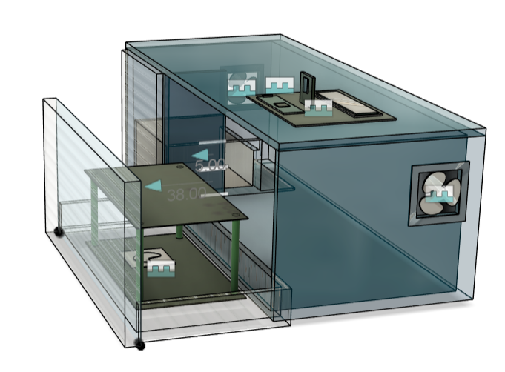
10.5 cm
23 cm
10 cm

Slide 4
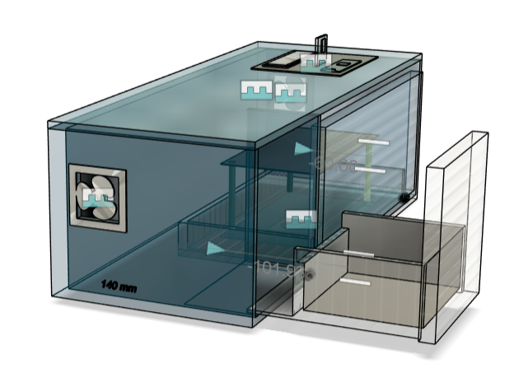
10.5 cm
10.3 cm
11 cm

Slide 5
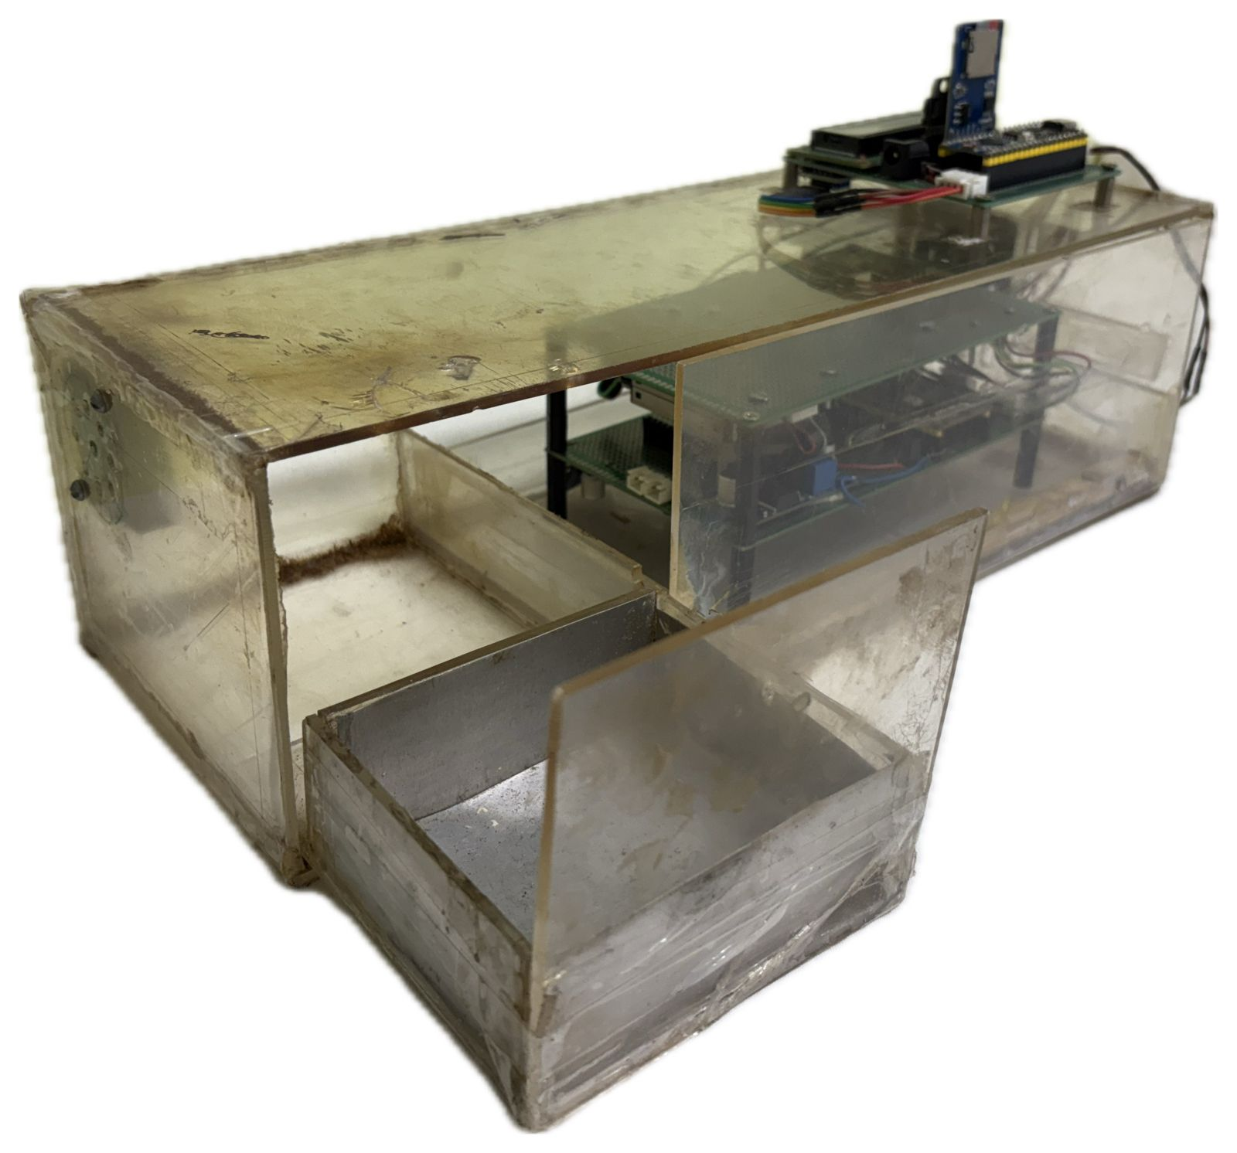
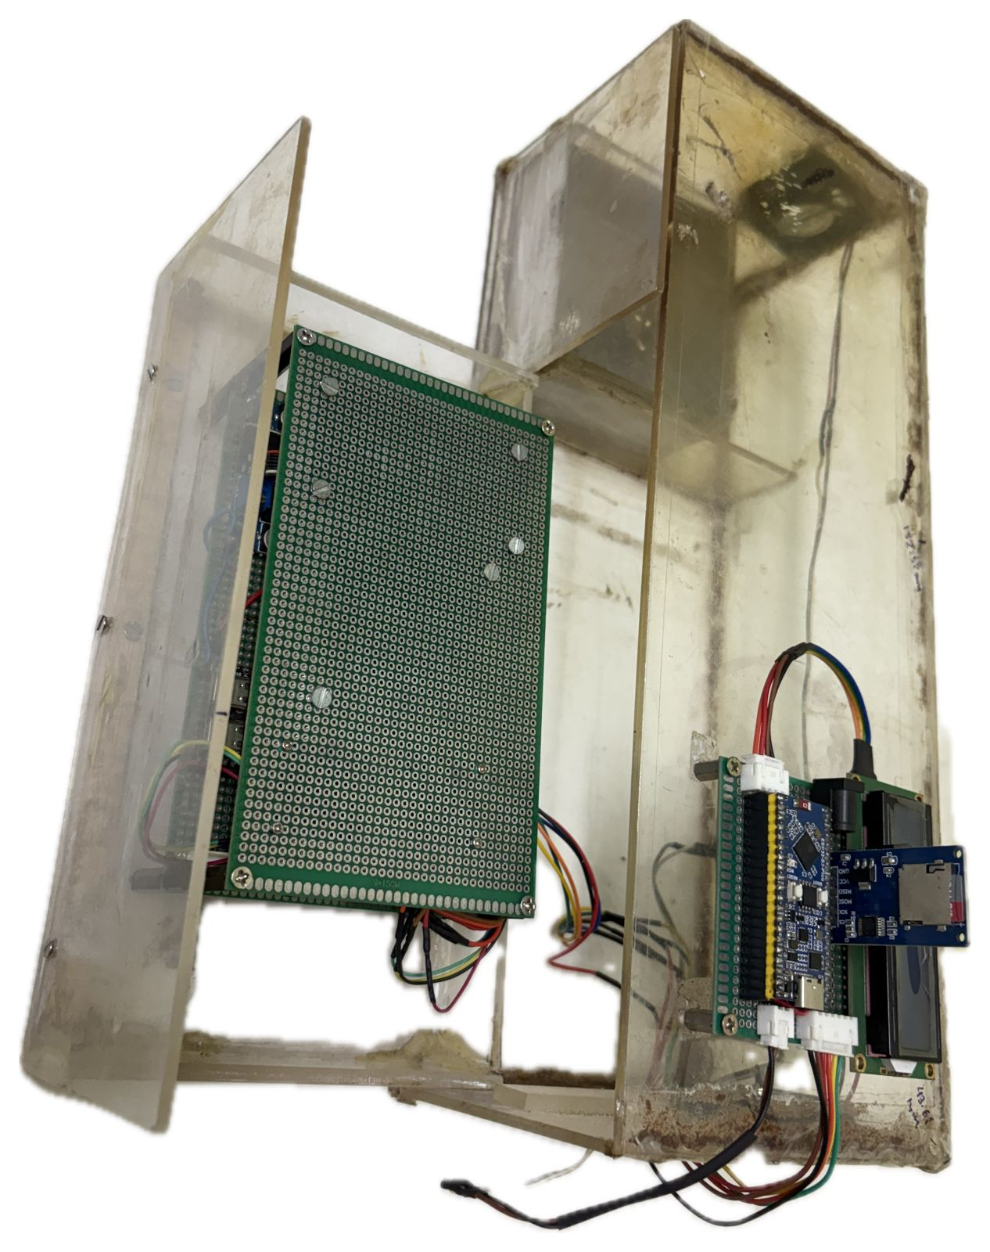

Slide 6
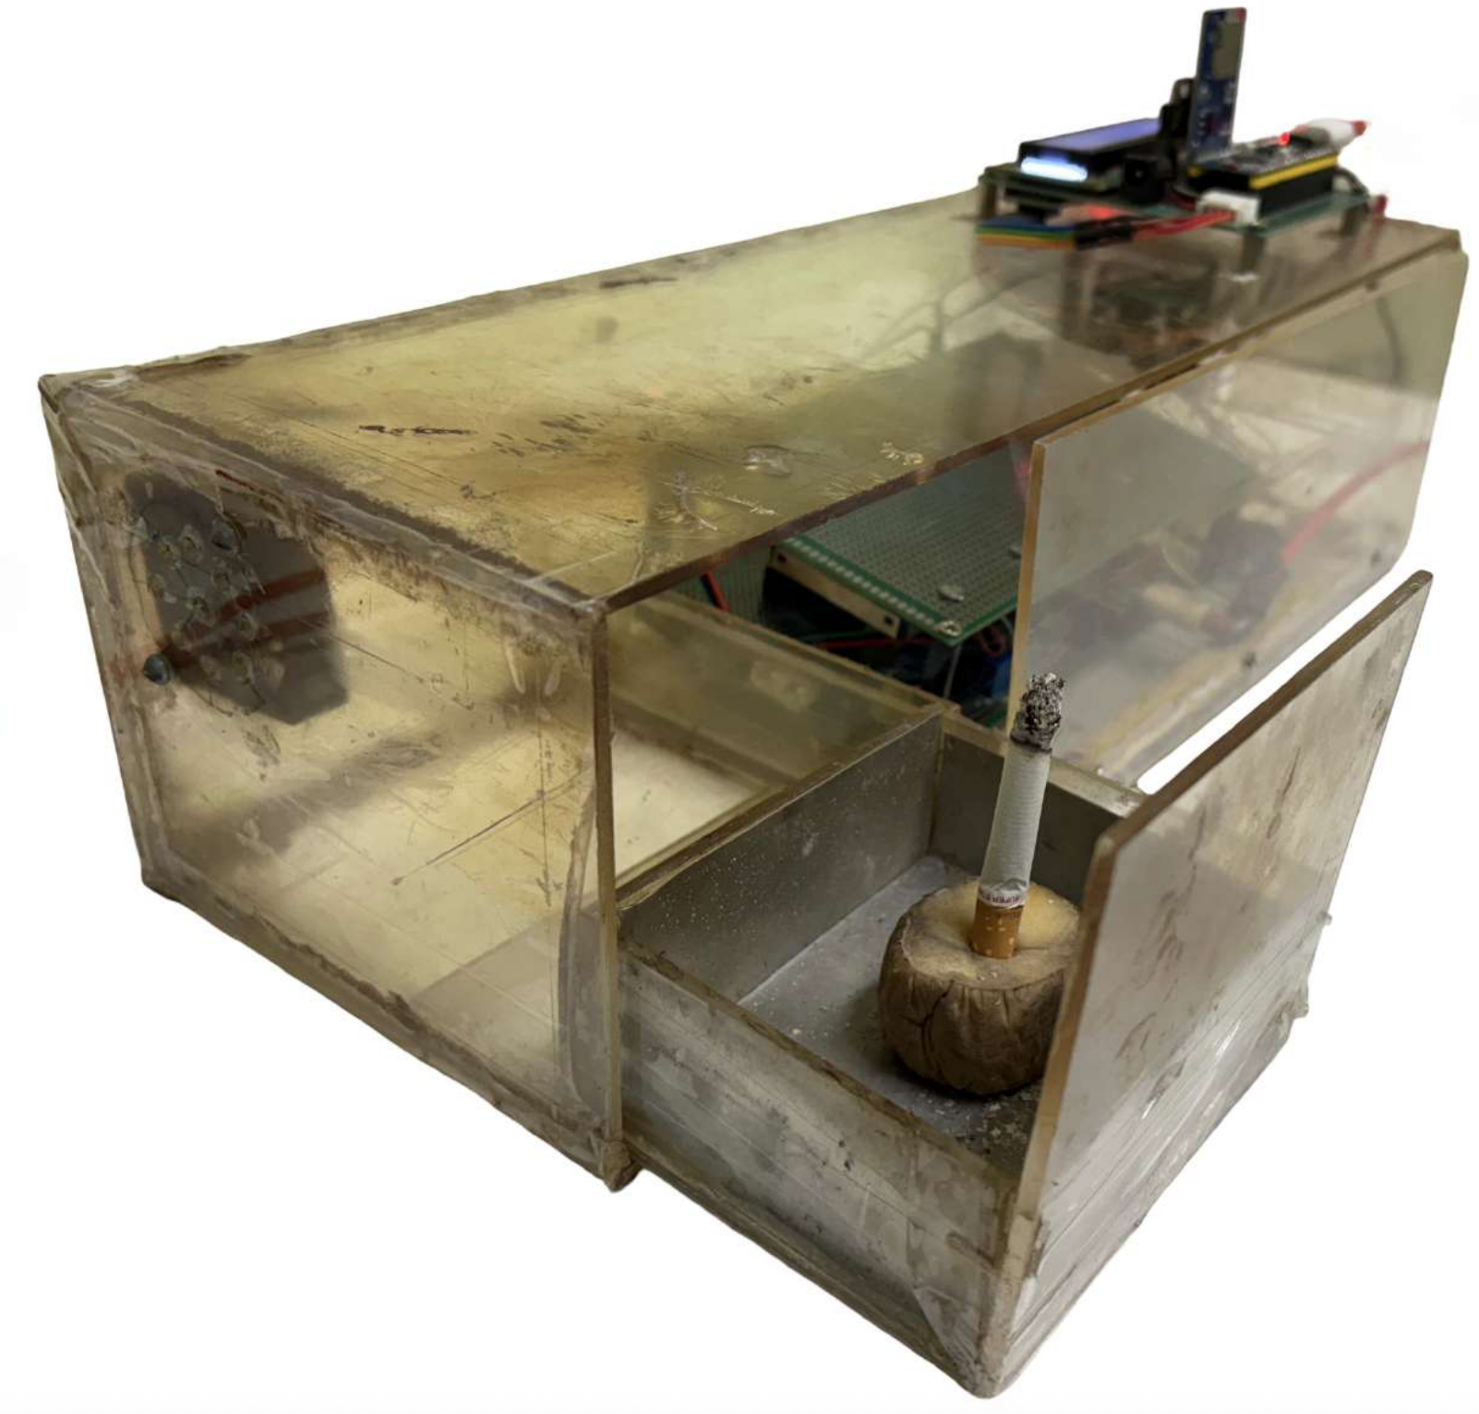
Inlet Fan
Activity Slot

Slide 7
